Slide 1
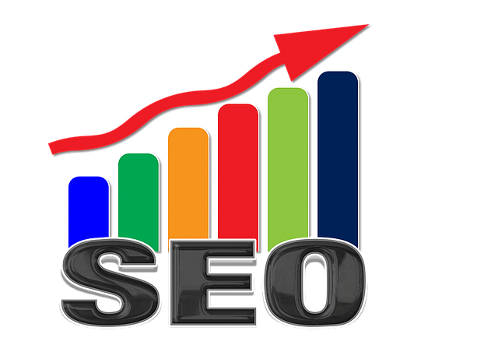

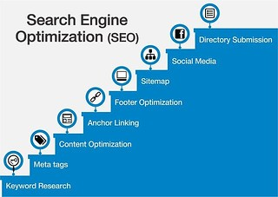
SEO PROJECT
Comprehensive SEO audit and optimization for organic growth
Name: Subiksha s | Batch code: MBE 11

Slide 2
Company selection
I selected cognizant (Intuition engineered—human insight, superhuman speed | Cognizant India) for the SEO project.
About Cognizant:
Cognizant is a leading global professional services company that specializes in digital transformation, consulting, and technology services. The company offers a wide range of services, including digital strategy, technology consulting, software development, and business process outsourcing, to help clients drive growth and improve efficiency.
Services:
Consulting services
Technology services
Digital services
Cybersecurity services
Artificial intelligence and automation

Slide 3
Project objective:
This project focuses on identifying and addressing SEO issues, implementing best practices, and improving the site's visibility and ranking on search engines.
To conduct a thorough SEO audit and implement optimization strategies to
Increase organic traffic,
Improve search engine rankings, and
Enhance overall online visibility.

Slide 4
Project tasks 1.Initial task
Current performance of the webpage:
Overall performance of the website is very good.
Page speed score: Mobile
Overall performance score : 94
Accessibility: 95
Best practices:96
SEO: 85

Slide 5
Page speed score: Desktop
Overall performance score : 100
Accessibility: 91
Best practices:96
SEO: 85
https://pagespeed.web.dev/analysis/https-www-cognizant-com-in-en/iyrypulevy?form_factor=mobile

Slide 6
Performance metrics
Desktop
Mobile
Largest Contentful Paint (LCP): 2.4 s
Interaction to Next Paint (INP): 250 ms
Cumulative Layout Shift (CLS): 0.02
First Contentful Paint (FCP): 1.6 s
First Input Delay(FID): 31 ms
Time to First Byte (TTFB): 0.9 s
https://pagespeed.web.dev/analysis/https-www-cognizant-com-in-en/iyrypulevy?form_factor=desktop
Largest Contentful Paint (LCP): 2 s
Interaction to Next Paint (INP): 104 ms
Cumulative Layout Shift (CLS): 0.02
First Contentful Paint (FCP): 1.2 s
First Input Delay(FID): 3 s
Time to First Byte (TTFB): 0.6 s
https://pagespeed.web.dev/analysis/https-www-cognizant-com-in-en/iyrypulevy?form_factor=desktop

Slide 7
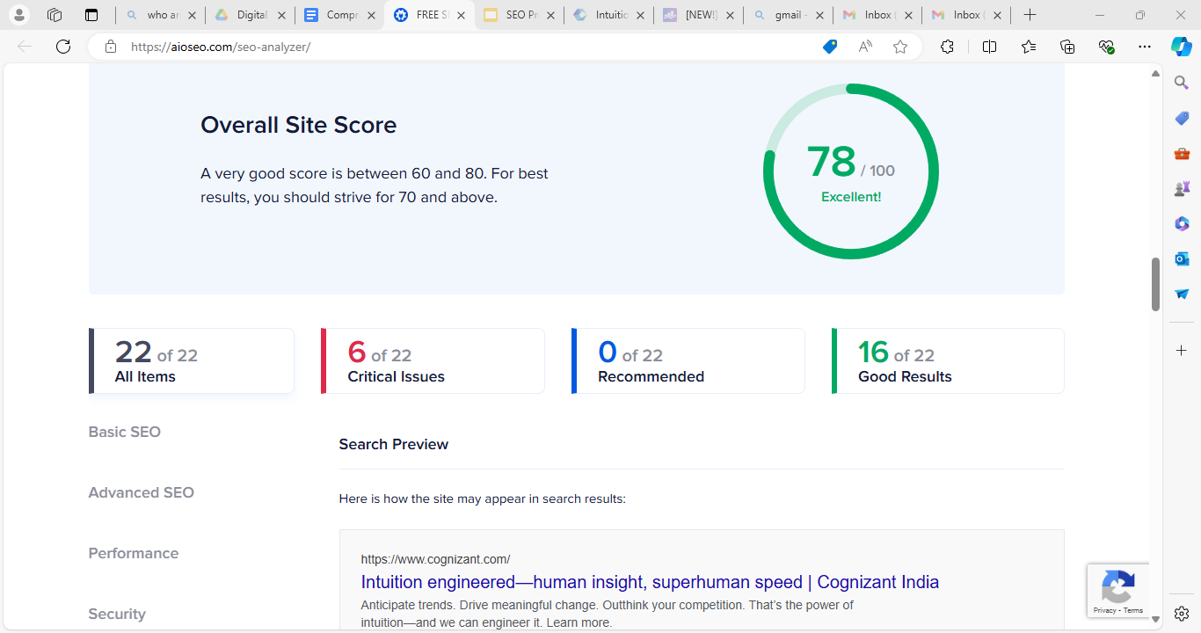
Overall site score:

Slide 8
Strengths
Advanced SEO is completely optimized and have good results.
The website is highly secured.
All the performance metrics have good score and some of them are needs to improve.
All Java script, CSS files appear are minimised.
The homepage is linking the canonical tag.
The website contains Robot.txt file.
The H2 tags are present in the website.
All the required opengraph meta tags have been found.

Slide 9
Weakness
Too many H1 tags on the homepage
Some images on the text have to alt attribute.
No common keywords present in the page description.
Tools used : FREE SEO Analyzer Tool - Generate Website SEO Audit Report (aioseo.com) – SEO analyzer
SEO Analyzer - Generate a Free SEO Report of Your Website (rankmath.com)- Rankmath

Slide 10
2. Keyword Research
Targeted keywords based on their services:
Primary keywords | Secondary keywords | Long tail keywords
Generative AI for business | Technology solutions professional | Cognizant technology solutions
AI tools for business | Digital transformation | Cognizant consultancy services
AI business automation | Corporate digital transformation | Business transformation consulting services
AI service providers | Cloud consulting | Professional technology services
AI technologies | Business transformation | Cloud transformation strategy
Latest automation technologies | IT service provider | Quality engineering and assurance
Intelligent automation | Digital engineering services | Digital business transformation services

Slide 11
Competitive analysis:
AI tools for business and generative AI for business, AI business automation are competitive.
Basically this company provides automative AI services for the business it is required to analyse the competitor analysis for keyword. As this will enhance the website traffic and lead generation of the business.
The keywords are mostly based on the AI services they can also use other services like cloud technology for keywords as this will lead to peculiar reach to the clients.
The major competitor companies are Accenture, TCS, Wipro etc.,

Slide 12
3. On page SEO
Selected pages : Welcome to careers at Cognizant | Cognizant Careers\Cognizant News & Events | Cognizant Press Releases - Cognizant Technology Solutions\Investor Relations | Cognizant
1.Cognizant careers page:
Strengths:
1. Title : The SEO title is set and is 51 characters long which is good.
2. Meta description: Meta description was found and it is 108 characters long.
3. Headings: H1 and H2 tags were found on the homepage.

Slide 13
Weakness:
1. Image Alt attributes: Some images on the homepage have no alt attribute.
2. Keywords in title and description: No common keywords were found in the page description.
How to fix it:
1. By using clear and concise language to describe the image's content. This helps search engines understand the image and improves accessibility for users relying on screen readers. And including keyword naturally in the alt text without stuffing.
2. By updating the meta description to include the target keywords naturally. Ensure the description is relevant to the page content and is around 150-160 characters long.
Incorporating primary keywords seamlessly into our meta description to align it with the page's content and improve SEO.

Slide 14
Cognizant News page:
Strengths:
Meta description: Meta descriptions were found and it is 94 characters long.
Keywords in title and description: One or more keywords were found in the title and description of the homepage.
Weakness:
Title: The homepage SEO title is 83 characters which is too long.
Headings tags: No H1 and H2 tags were found in the homepage.
Image Alt attributes: Some images on the homepage have no alt attribute.
Links ratio: Few internal links(24) compared to external links(121).

Slide 15
How to fix it:
1. An SEO title should ideally be between 50 to 60 characters to ensure it displays fully in search engine results without being cut off.
2. By ensuring that each page has a single, unique H1 tag that clearly reflects the main topic, avoid multiple H1 tags.
3. By using clear and concise language to describe the image's content. This helps search engines understand the image and improves accessibility for users relying on screen readers. And including keyword naturally in the alt text without stuffing.

Slide 16
Cognizant investor page:
Strengths
Title: The title of the homepage has 35 characters which is good.
Meta description: Meta description was found and it is 82 characters long.
Headings: The H1 and H2 tags were found.
Keyword in title and description: One or more common keywords were found in the title and description of your homepage.
Weakness:
Image ALT Attributes: Some images on the homepage have no alt attribute.
How to fix:
Regularly check and update alt tags as you add new images to your site to maintain SEO performance.

Slide 17
4. Technical SEO
Current technical SEO status:
Indexability and crawlability: The website page is using robot.txt, XML sitemap, and meta robots tags which helps the search engines to index and crawl the webpage.
Canonicalization: The page is using canonical link tag.
Website speed optimization: All the CSS files appear to be minified but some of the Java script files don’t seem to be minified.
Response time: The response time is 0.2s which is great.
HTML document: The size of the HTML document is 36kb.
HTTPS security: The site is using a secure transfer protocol.

Slide 18
Technical issues on the homepages and other pages
The server is not using expires head for images.
Some Java scripts are not seem to be minified.
The page makes 29 requests. More than 20 requests can result in slow page loading.
The size of the HTML document is more than 50kb.
The robots.txt file is missing in news page.
These are the common technical issues faced in the webpages.

Slide 19
Best practices to improve site and webpage speed
By using the Apache or NGINX web servers, we can edit the configuration files to set the "expires" header for all image files. For Apache, we can also use a ".htaccess" file to change the settings for each folder.
We can minify JavaScript using online tools like UglifyJS or Terser. By setting up event tracking in Google Analytics we can monitor the script load times and interactions.
Replacing embedded objects with HTML5 alternative we can reduce the page requests which will increase the page speed.
Keeping the HTML document size below 50kb ensure faster loading times and better performance.
News page does not have robots.txt file it will affect the indexability and crawlability of the page.

Slide 20
5. Content strategy
Developing content based on the targeted keywords and client needs
Blog topics:
"The Role of Cloud Computing in Accelerating Digital Transformation in the Enterprise“
"Digital Transformation Success Stories: How Leading Companies Leveraged Cloud Technology“
"How Digital Transformation is Revolutionizing the Future of Business Operations“
"AI and Machine Learning in the Cloud: Driving Digital Transformation with Intelligent Solutions“
"Building a Generative AI Strategy: What Every Business Leader Should Know“
"Real-World Applications of Generative AI: Success Stories from Leading Industries"

Slide 21
By creating blog posts and case studies above topics it will be more effective for the clients to understand their service objectives.
Regular updation and analysis of the blog posts will help to keep the content updated and informative.
Posting all the blogs on social media profile will also help to increase the traffic on the website and keep the audience engaged.
New and fresh information should updated in the blog more often for better understanding of the blogs.

Slide 22
6. Off page SEO
Backlinks:
The website have high-quality backlinks from authoritative and relevant websites.
The anchor text used in backlinks is relevant and varied.
There are totally 1.8k backlinks found in the page and 82% of the links are “dofollow” links which will increase the destination website’s search rankings.
And there are 456 linking websites found in the page in which 75% of them are “dofollow” links.
The overall domain rating for backlinks is 81 which is good.

Slide 23
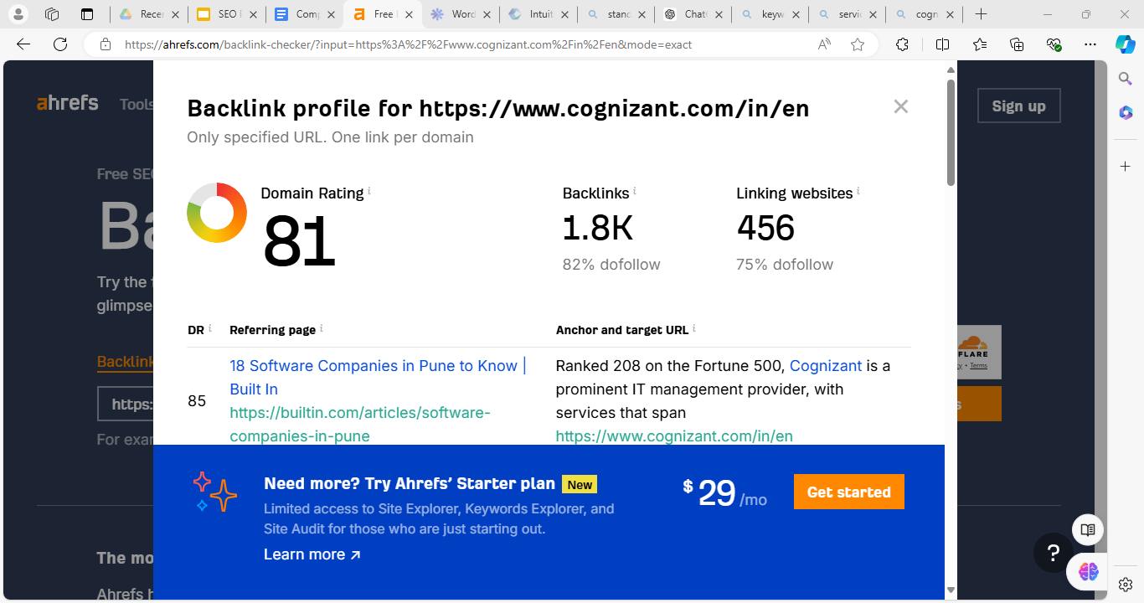
Free Backlink Checker by Ahrefs: Check Backlinks to Any Site

Slide 24
Social media engagement: By monitoring the content posted on social media platforms to advertise our expertise to the broader audience which will enhance company’s profile.
Building broken links: Identifying broken links on authoritative sites in the industry and suggest our content as a replacement will help increase the traffic.
Online reputation management: Monitoring and responding to reviews on platforms like Google My Business, Yelp and industry-specific sites will help to maintain a quality of the content posted and clients opinions on the recent activities of the business.
Guest blogging: By contributing to guest blog with relevant topics to run more backlinks for the website.

Slide 25
Project deliverables
Detailed SEO audit report highlighting current performance and areas for improvement.
Keyword research report with targeted keywords and competitive analysis.
Share the on-page SEO report and findings.
Share the technical SEO issues and improvements on the website, along with best practices.
Provide the content strategy plan for the selected website.
Outline the off-page SEO plan and strategy for the selected website.

Slide 26
Project conclusion
The "Comprehensive SEO Audit & Optimization for Organic Traffic Growth" project successfully identified and addressed critical SEO issues, enhancing the website’s visibility and search engine ranking.
Through detailed audits, targeted keyword research, on-page and technical SEO improvements, and strategic content and off-page SEO planning, the project has laid a solid foundation for sustained organic traffic growth.
The deliverables, including comprehensive reports and strategic plans, provide clear guidance for ongoing SEO efforts to maintain and build upon these improvements.

Slide 27
Thank you !!

